Slide 1
General denoising methods

Slide 2
Supervised training strategies
Supervised 1: 1 fast dwell time image (blue) trained vs. 1 slow dwell time image (green)
similar to Noise2Noise
Supervised 3: 3 adjacent fast images trained vs. 1 slow image, a stack version of Noise2Noise
Supervised 5: 5 fast images trained vs. 1 slow image
etc
t-1
t0
t+1
t0

Slide 3
Unsupervised training strategies
Unsupervised 2: 2 fast dwell time images trained vs. 1 fast dwell time image
similar to Noise2Stack
Unsupervised 4: 4 fast vs. 1 fast image
t-1
t+1
t0
t-2
t-1
t+1
t+2
t0

Slide 4
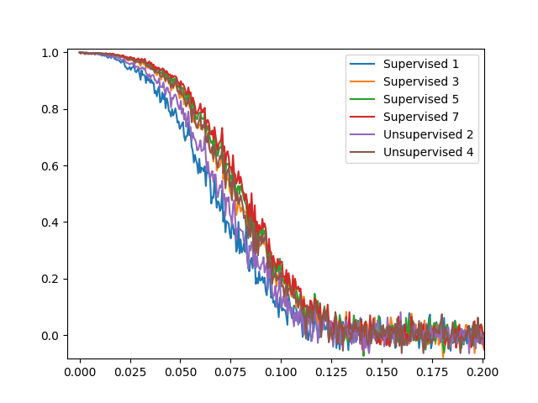
Comparison supervised/unsupervised 1
FRCs of denoised images vs. ‘slow’ reference (8ns)
Training with 400 epochs
Fast: 0.5ns; slow: 3ns
Unsupervised training performs similarly to unsupervised (same range of values)
Inclusion of more adjacent images improves both PSNR & FRCs, however the metrics both plateau above 5 input fast images, sweet spot seems to be 3 to 5
Collection of slow image (eg supervised training) only allows visual examination of denoising efficiency
Strategy | PSNR
Supervised 1 | 22.25
Supervised 3 | 22.32
Supervised 5 | 22.41
Supervised 7 | 22.39
Unsupervised 2 | 22.26
Unsupervised 4 | 22.33
FRC
Spatial frequencies (0.2 to 0.5 ignored)

Slide 5
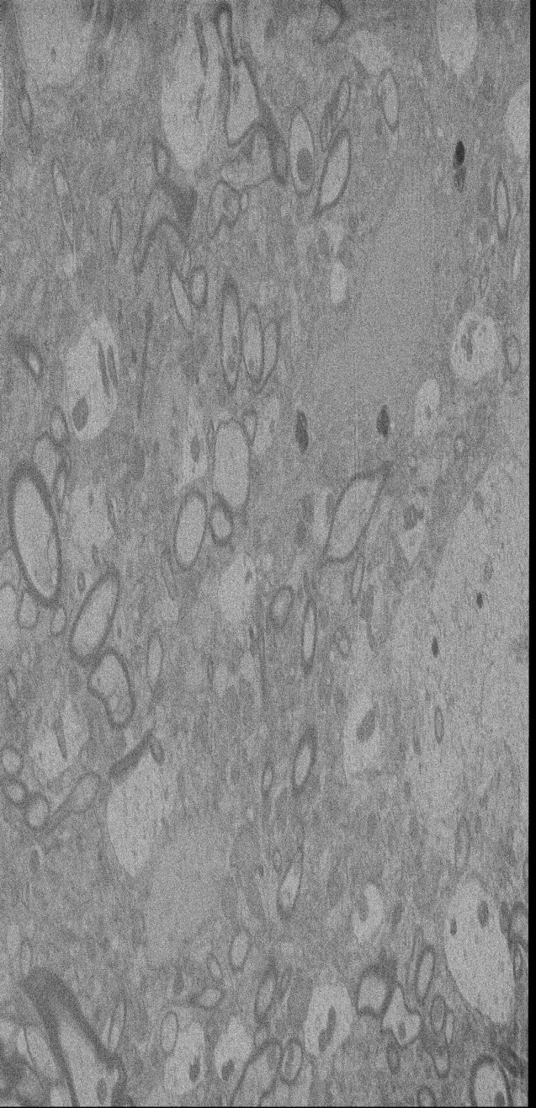
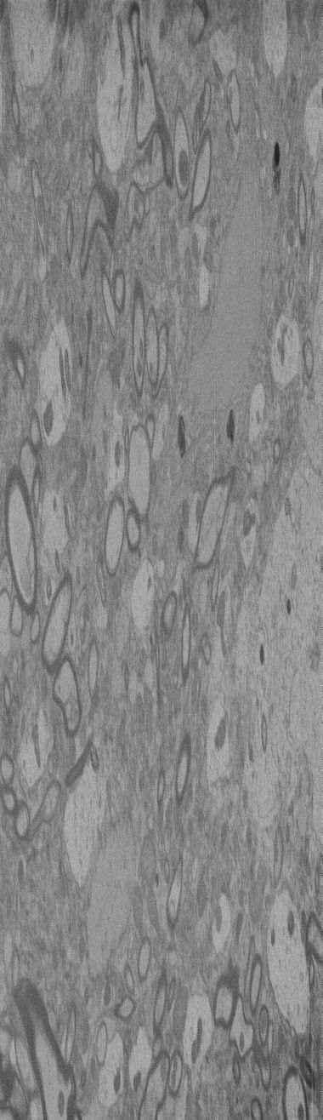

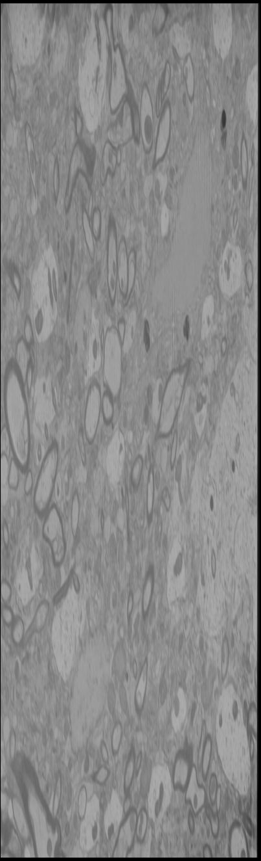
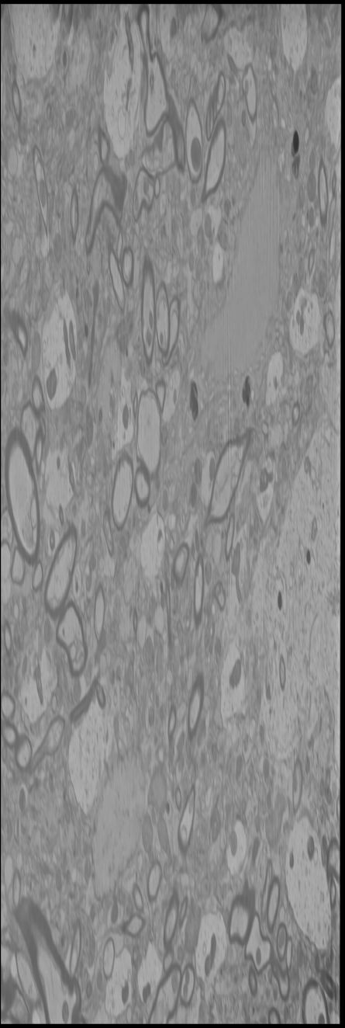
Comparison supervised/unsupervised 2
0.5ns
3ns
Supervised 1
Unsupervised 4
Supervised 5
The numbers check out visually: more input fast images improves finer details, contours and overall contrast

Slide 6
Offline vs. online training 1
Offline training: Model trained after collection with all images (500 epochs)
Online training: Model trained in 4 steps with a fraction of the images (500 epochs)
To mitigate overfitting the strategy has been to:
- Use highest dropout rate until all the images are available
- Limit the number of epochs to perform until all images available (~early stop)
- Leave out some parameters until all images available
Steps were (so only 200 epochs performed after end of collection):
1. 100 epochs with 35% of images, dropout 0.5, effective network depth=2, initial learning rate=0.01
1. 100 epochs with 60% of images, dropout 0.5, effective network depth=3, initial learning rate=0.01x0.85
1. 100 epochs with 85% of images, dropout 0.5, effective network depth=4, initial learning rate=0.01x0.85^2
1. 200 epochs with 100% of images, dropout 0.3, effective network depth=5, initial learning rate=0.01x0.85^3
The effective depth of the network is changed by ignoring a portion of the decoder part. Cf next slide for brief explanation

Slide 7
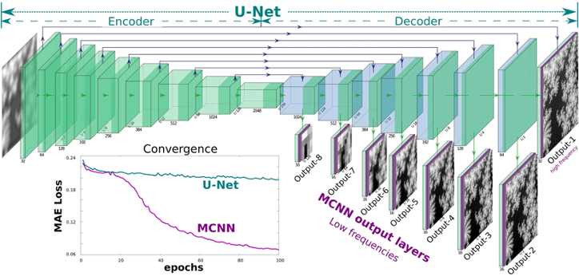
Offline vs. online training 2
Example taken from: https://doi.org/10.1038/s41598-020-62484-z
+ upsampling to image
original size
Full network, depth=8
Network, with effective depth 7
Decoder Leyel 8 parameters are not optimized and replaced with simple image upsampling (interpolation)
such that the output image is comparable to whatever reference image is used.
Because prior to upsampling the output image is smaller, this is equivalent to training only with the low resolutions (~frequency marching)
Indeed a bit faster. At an effective depth of 2, the training is 3-4 times faster for the same number of images

Slide 8
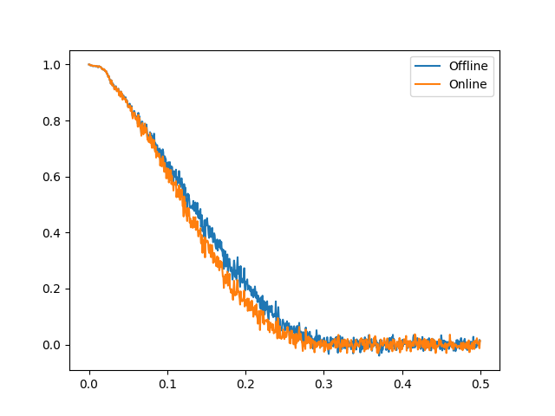
Offline vs. online training 3
FRC of denoised images vs. raw image
Trained with Unsupervised 2 and 70 images taken every 20 images from a 1400 dataset (Monica’s data, 221104_Drosophila_E14-220930, unknown dwell time)
Only showing for one denoised image but very representative of the hundreds I have denoised.
The PSNR is nearly identical and online training shows only a slight degradation in FRC, so this seems to be a viable strategy to initiate training prior to full collection. Visually the denoised images are indistinguishable
One could also think of using variable network depth (multi-resolution) as a way to speed up offline training.

Slide 9
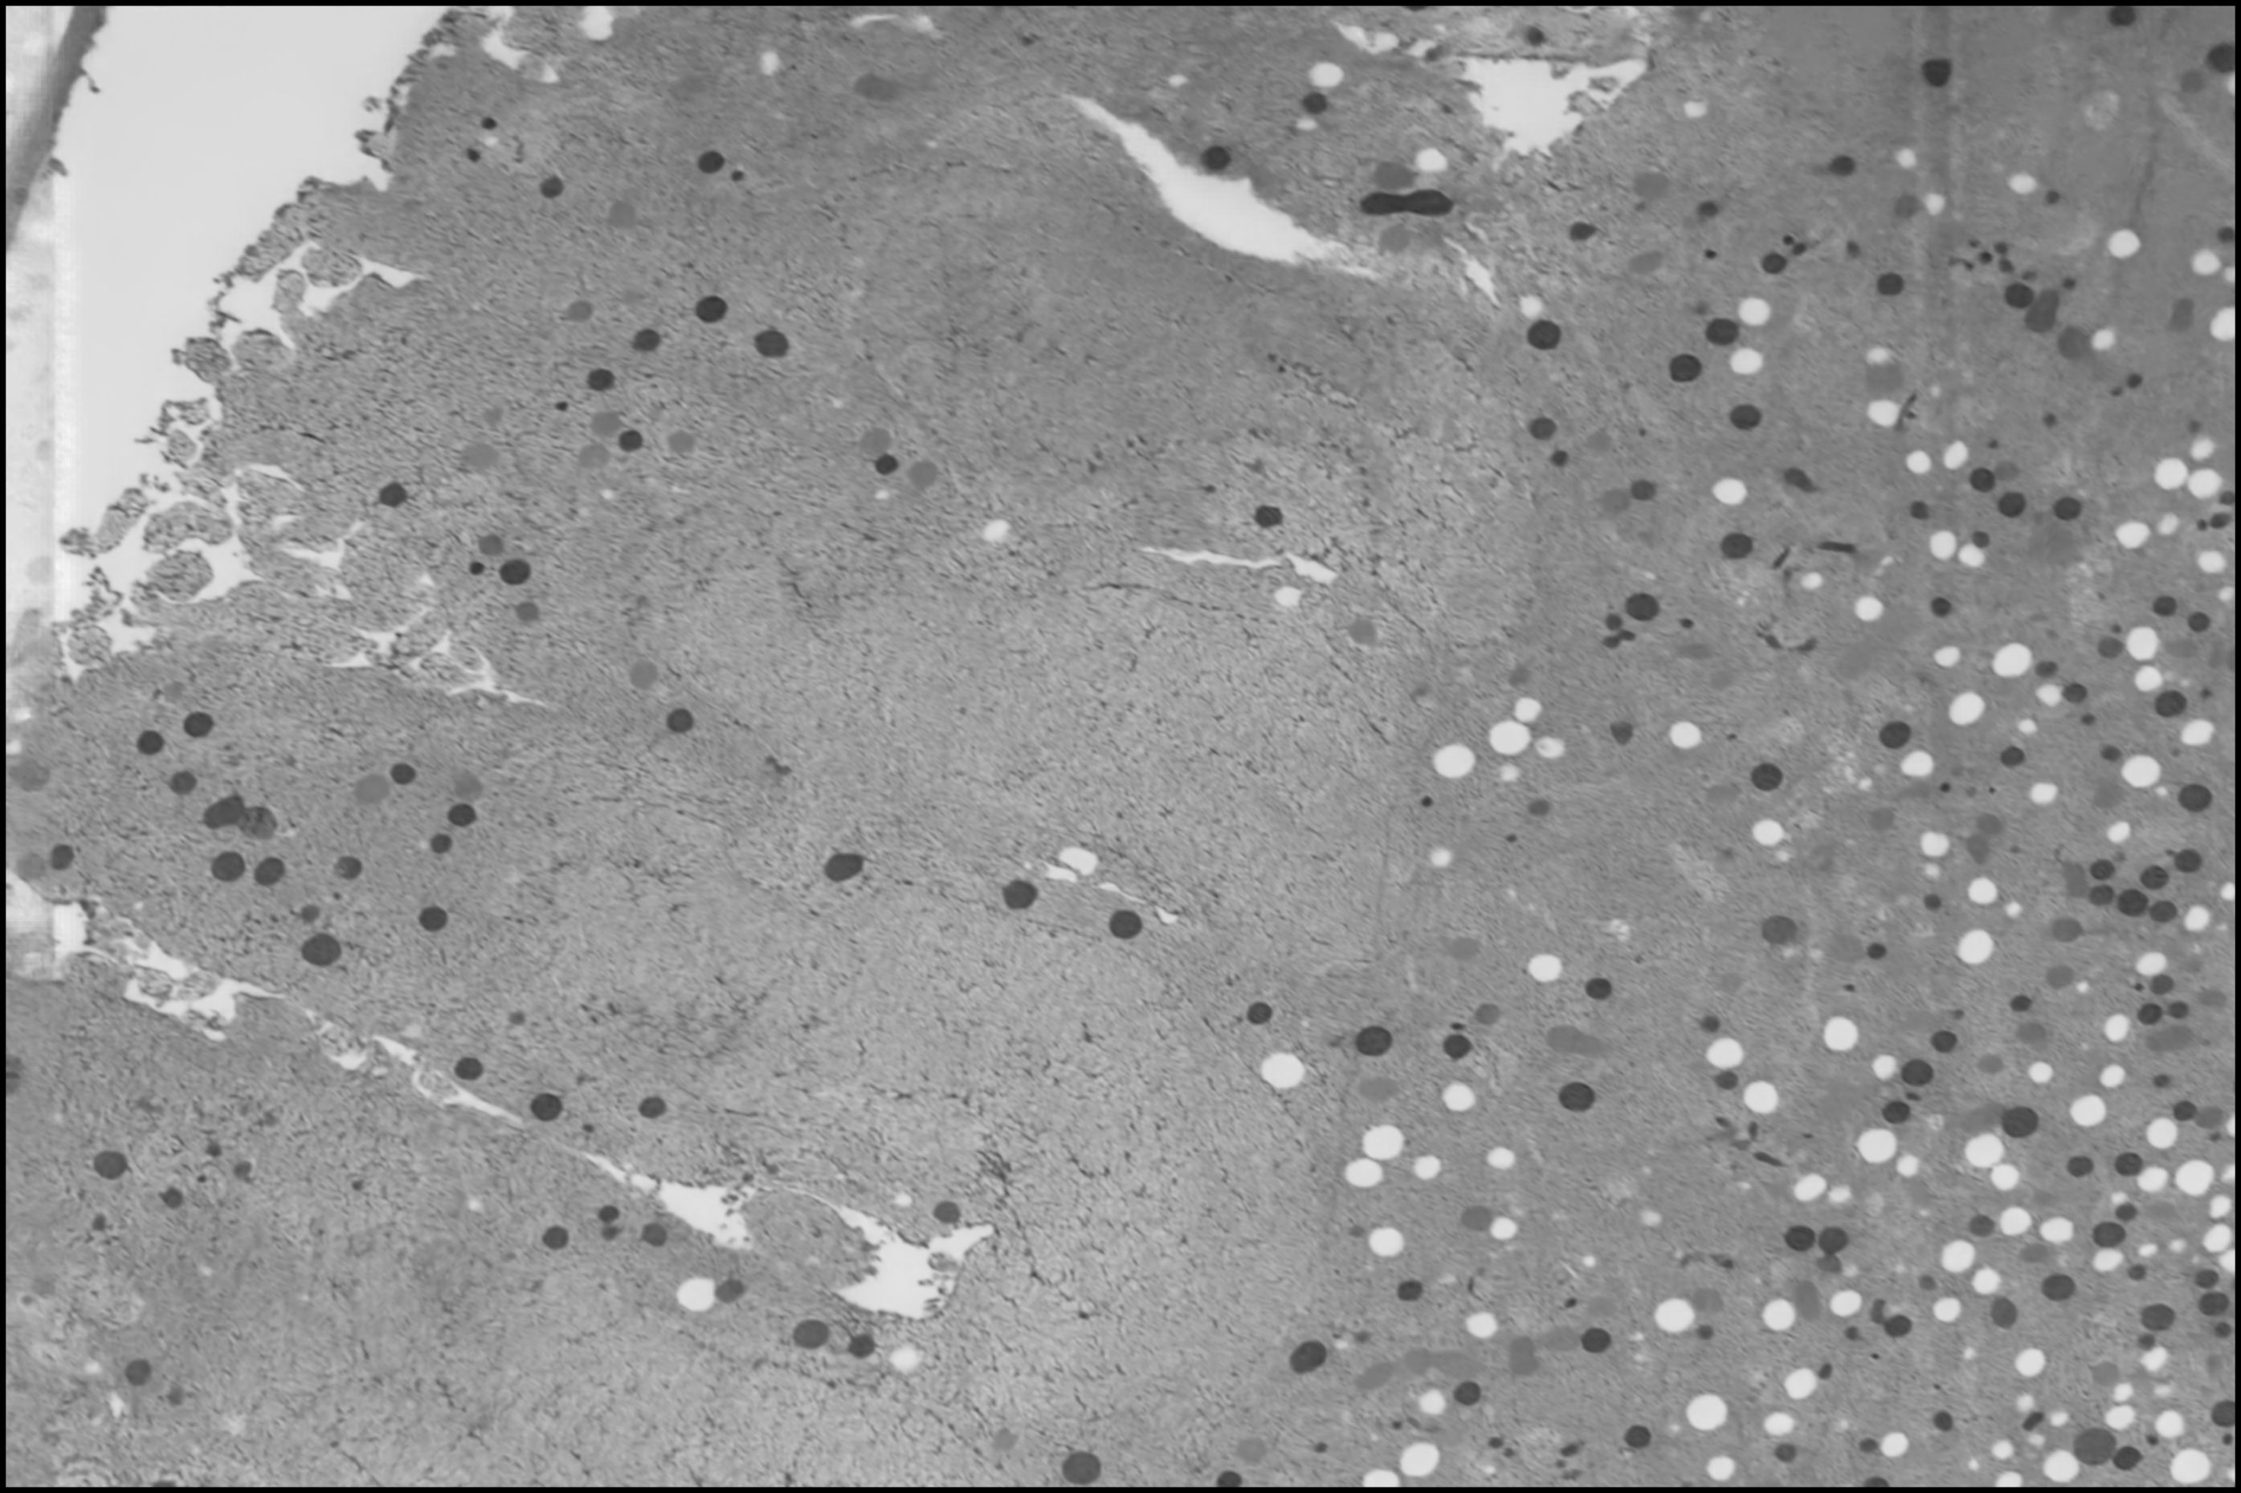
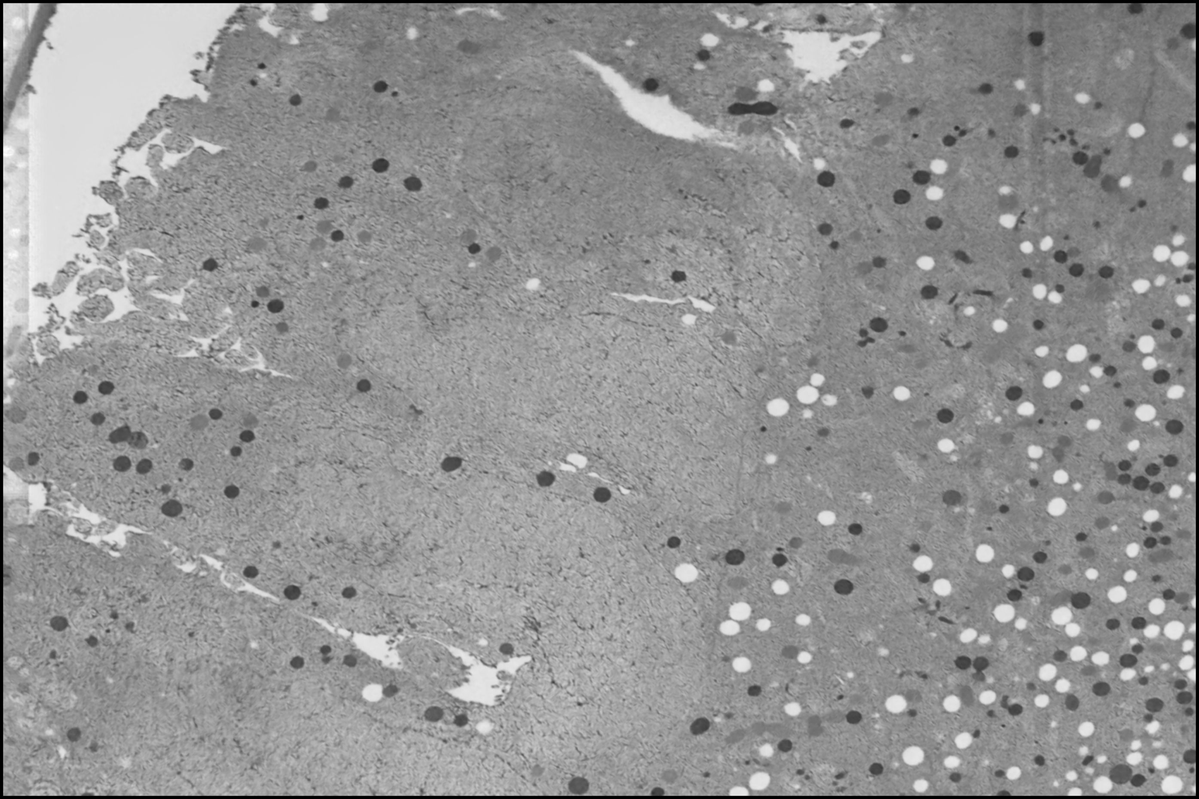
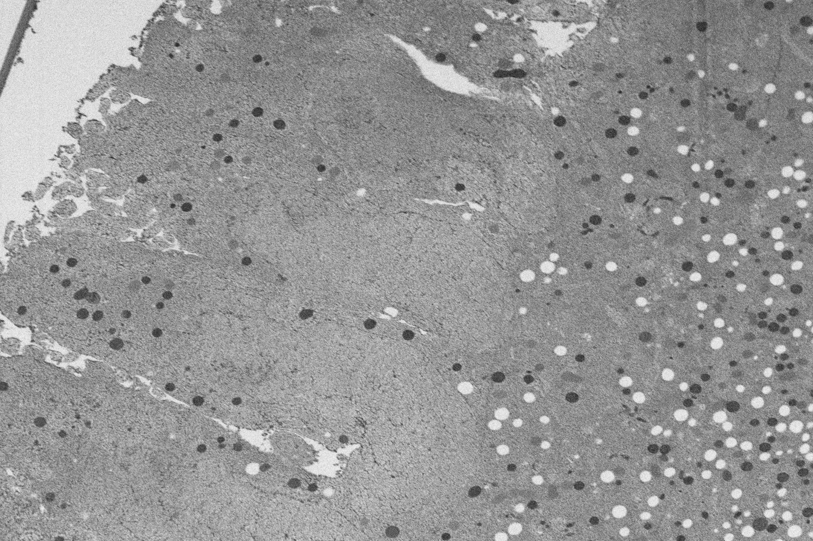
Offline vs. online training 4
online
offline
raw

Slide 10
Analysis under different imaging conditions

Slide 11
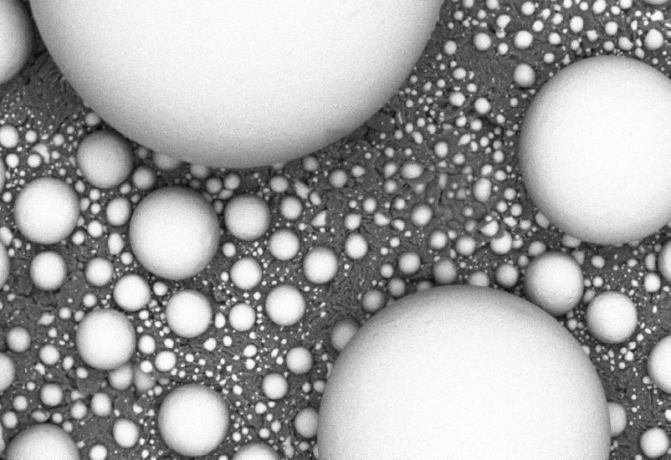
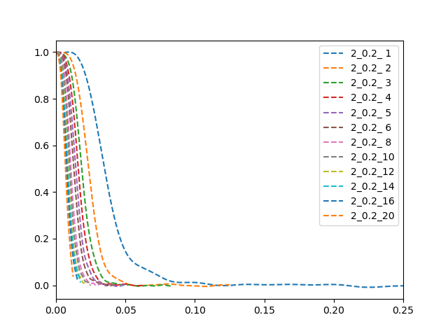
Influence of pixel size 1
2kV, 200pA, 5nm/pix, 2μs
Here the frequencies across images of different pixel size are made to match
(eg g=0.05 equates to 200nm-1 for all images), so unsurprisingly at high pixel size there is little in the way of medium & high resolution.
At the smallest pixel size (blue, far right) less than 10% of the frequencies have a significant correlation and therefore SNR.
Looking at different currents & 1kV the values are obviously different but the trends are identical.
Curves: Voltage(in kV)_Current(in nA)_PixelSize(in nm)
FRCs were calculated with a single image with PolishEM following https://doi.org/10.1038/s41467-019-11024-z. Therefore they are semi-quantitative and should be regarded as an upper bound.
The spectral range is limited to [0;0.25] at 1nm, then [0.0;0.125] at 2nm; [0.0;0.0625] at 4nm, etc.

Slide 12
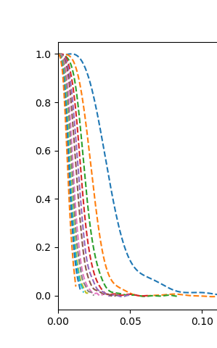
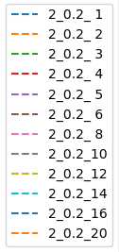
Influence of pixel size 2
Interestingly, decreasing the pixel size by a factor 2, for instance looking at 1 (far right blue) to 2nm (far right orange), makes the FRC drops sharply such that even the lower resolutions (say frc>0.5) are comparatively poorly preserved and are significantly impacted by noise.
The same applies from 2 to 4nm (far right red) and so on.
0.5

Slide 13
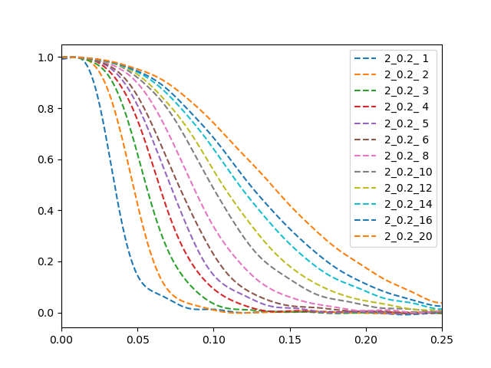
Influence of pixel size 3
Here the frequencies are not made to match and it should be seen as a quantification of how many frequencies have a significant correlation across their respective spectral range, or in other words what fraction of frequencies is best preserved by the imaging process (the spatial frequency is half this fraction)
Clearly, the higher the pixel size the better the preservation. Indeed at higher pixel size we are dealing with low resolutions and increased averaging of features and noise.
Curves: Voltage(in kV)_Current(in nA)_PixelSize(in nm)
FRCs were calculated with a single image with PolishEM following https://doi.org/10.1038/s41467-019-11024-z. Therefore they are semi-quantitative and should be regarded as an upper bound.
Spectral range does not match across images

Slide 14
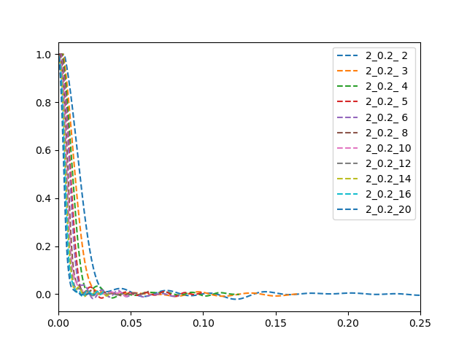
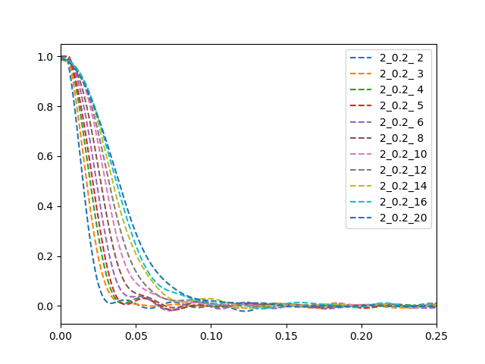
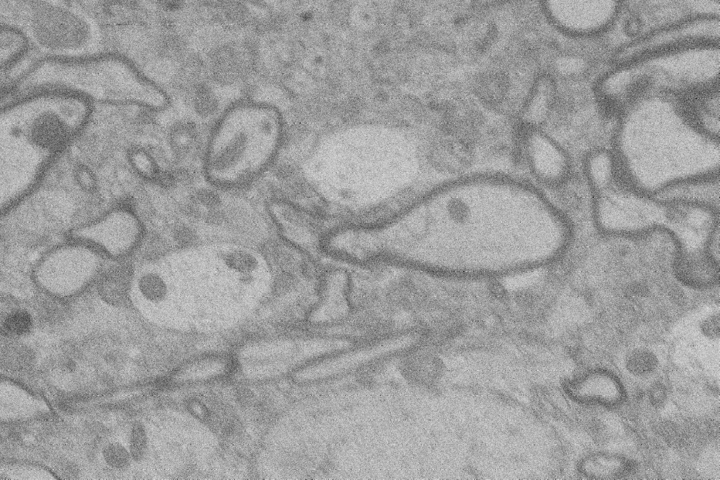
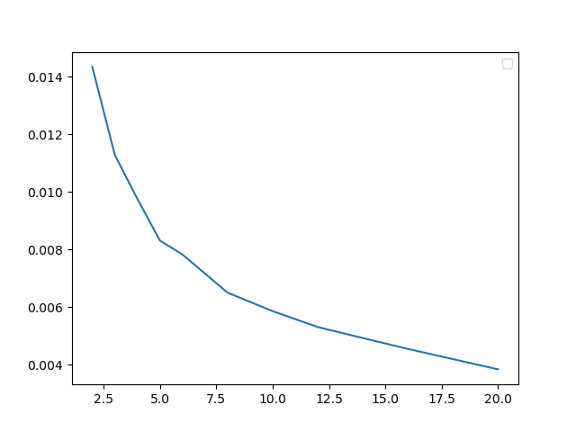
Influence of pixel size 4
2kV, 200pA, 5nm/pix, 2μs
In the case of the brain tissue, the conclusions are essentially the same, except a lot more information is lost (lower transmittance).
Plotting the frequency at frc=0.5 as a function of pixel size aims at getting an idea of how fast we are losing frequencies. This happens faster with small pixels.
Frequency at frc=0.5
Pixel size (nm)

